Slide 1
SMS Database and Zoned Input
Meeting June 18, 2024

Slide 2
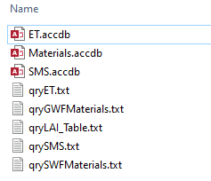
Database folder

Slide 3
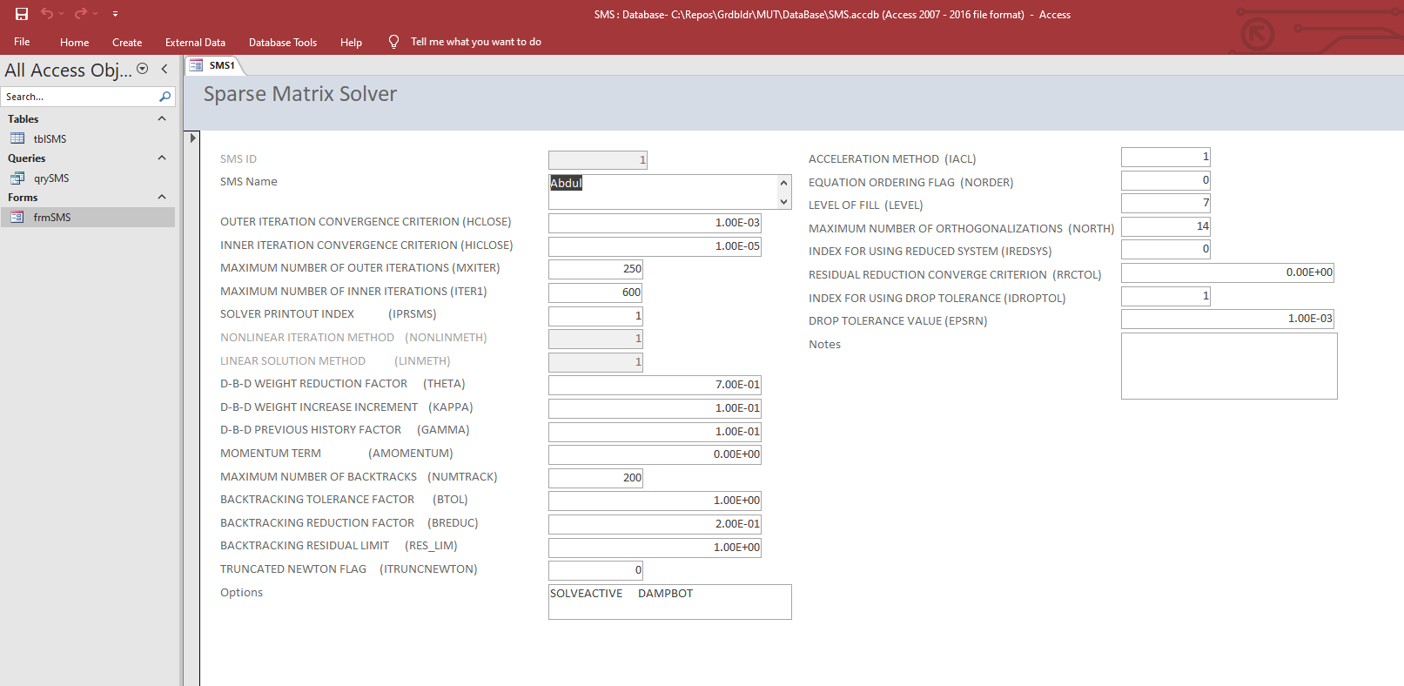
SMS Database input form
SMS ID is disabled (autonumber)
Currently NONLIMETH and LINMETH user input is disabled so forces use of Newton-Raphson approach and Chi-MD Solver

Slide 4
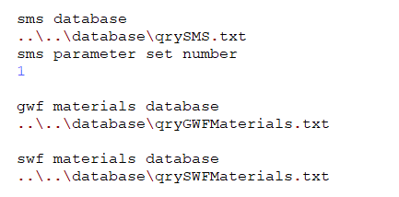
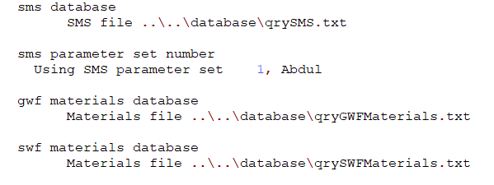
Database setup in MUT file
Input from .mut
Output to .eco

Slide 5
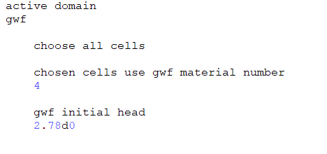
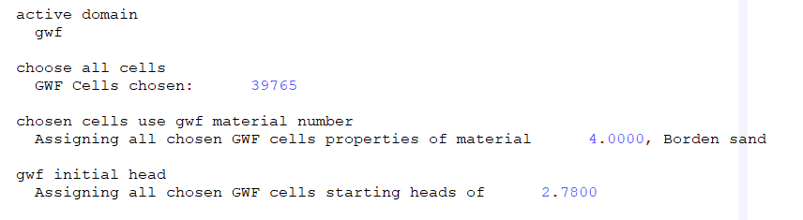
GWF Material property setup in MUT file
Input from .mut
Output to .eco

Slide 6
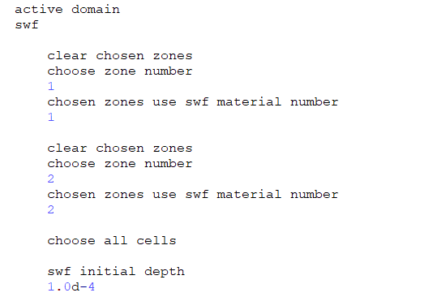
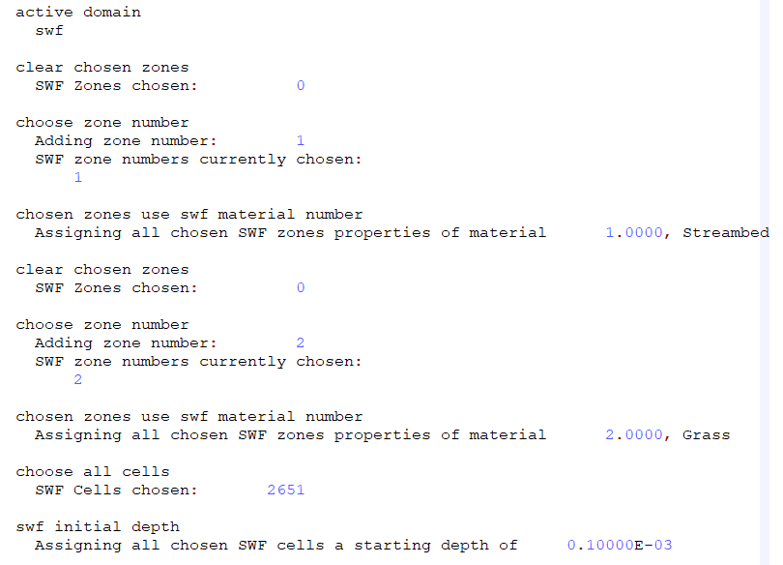
SWF Material property setup in MUT file
Input from .mut
Output to .eco
SWF-GWF connection length is a cell-based parameter that defaults to 0.001 so no input required here unless you want to change it

Slide 7
Next Steps
Finalize SMS, SWF and ET Database inputs
User’s Guide
Implement a 2D (template) face/neighbour/element scheme in fortran instead of using Tecplot
Current Tecplot approach doesn’t work for CLN or Quadtree
Implement kriging and rasters in pre-processor for surface elevations
Implement outer boundary import to use as mesh cookie cutter in pre-processor
Make sure all examples can be built in pre-processor
User-defined zones

